Slide 1


Understanding the spread of covid-19 in Ireland using s-i-r model and logistic growth function
Student Name: Neeraj Waman Chavan
Student Number: 10521393
Supervisor: Prof. Amir Esmaeily
Contact: 10521393@mydbs.ie

Slide 2
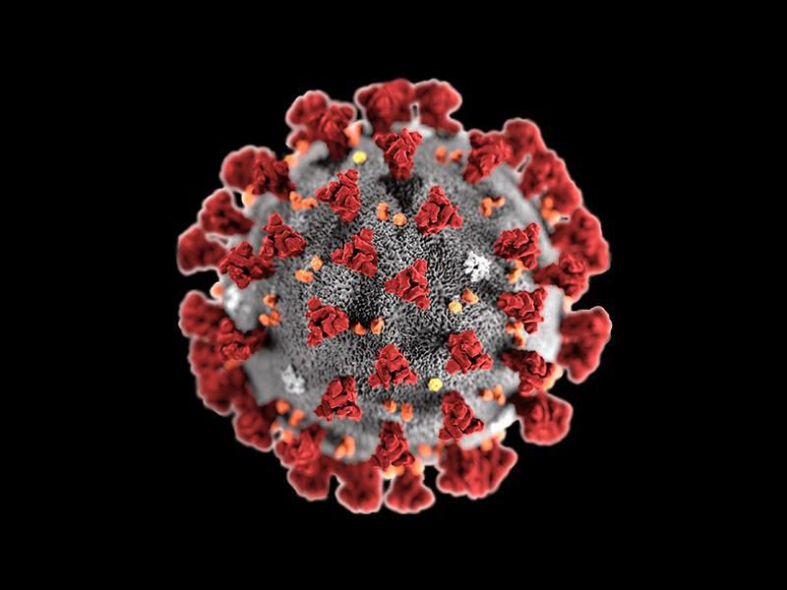
Introduction

Slide 3
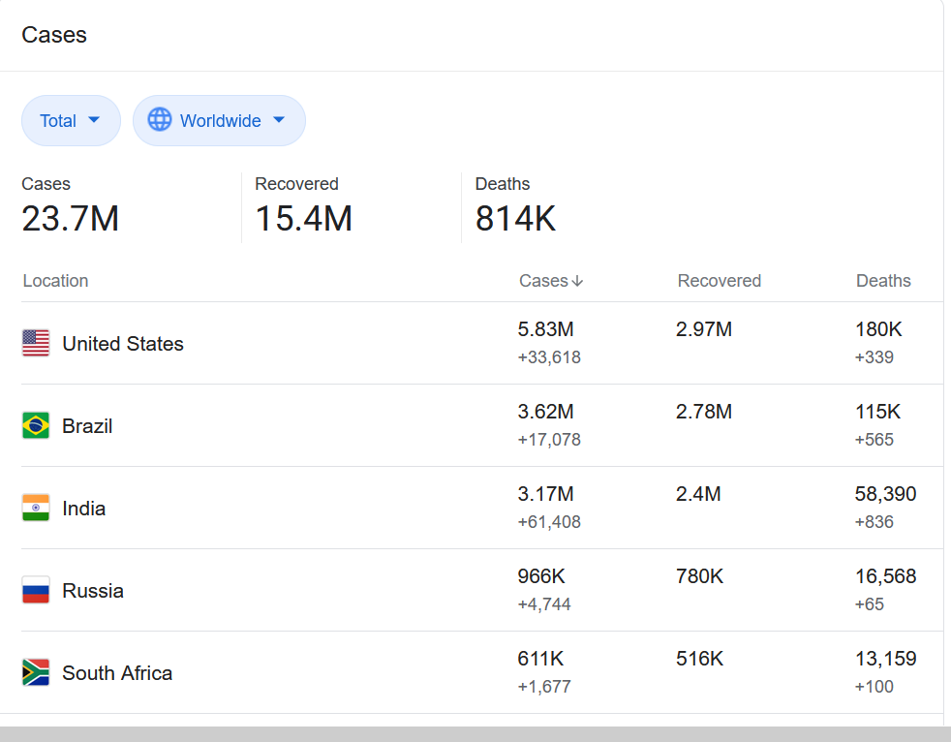
COVID-19 and its origin
Outbreak happened in Wuhan province of China and later spread to Hubei and eventually propagated worldwide
Declared a pandemic by WHO on 11th of March 2020
23.7mn confirmed cases as of August 25th
Why is it necessary to model the behavior of covid-19?
To implement public health measures
To understand how the virus is propagating in a population
To take strategic decisions of allocating economic and health resources
To identify the general trends in the transmission behavior of the virus

Slide 4
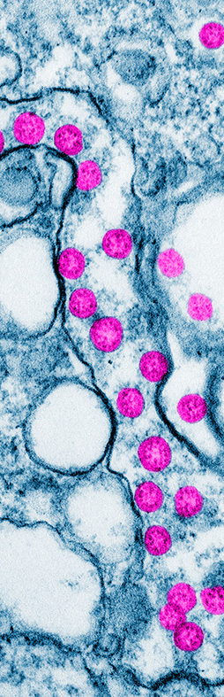
Research AIMS & Objectives
To analyze and understand the spread of the COVID-19 outbreak using the epidemiological S-I-R model and the Logistic Growth Model
To understand how the virus is propagating in Ireland and if the measures of lockdown implemented have an effect of the spread of the virus
To simulate and forecast the propagation and transmission dynamics of the virus
To compare the results obtained from both these models and analyze and better understand these models in terms of epidemiology and data analytics
To identify the general trends in the transmission behavior of the virus

Slide 5
Literature review- existing research which inspired me
Dhanwant and Ramanathan, studied the spread of COVID-19 in India using the S-I-R model and studied the effect of imposing a lockdown on the spread of the virus
Similarly Igelsias and Juez in their research implemented the S-I-R model to analyze the spread for the first 15 days in Madrid
S. Kucinkas used the SIR model coupled with Kalman Filter to estimate the reproduction number R0 for worldwide cases
B.Rai, Shukla and Dwivedi used an exponential model to predict the growth of COVID-19 cases
Bliznashki used the Logistic Growth Model to simulate the spread of COVID-19 in New York using Bayesian Estimation Method
Wang and Sornette implemented the logistic growth model to study the outbreak in China and the model was implemented to study the different stages of the outbreak

Slide 6
Literature review- DISCUSSION
Dhanwant and Ramanathan estimated the value of beta(transmission rate) as 0.1. Also, the values of beta were estimated for when the lockdown was imposed and when the lockdown was not imposed. However, while fitting the data for Italy the model did not give satisfactory results
Similarly Igelsias and Juez in their estimated the R0 value using Monte-Carlo simulations based on the number of infected people during the early stages of the outbreak. It was estimated to be around 2.22
B.Rai, Shukla and Dwivedi used an exponential model to predict the growth of COVID-19 cases but the exponential model does not account for the flattening of the curve

Slide 7
Methodology
Data Collection and Pre-Processing
Data collected from multiple sources
Exploratory Data Analysis
Data Modelling
Simulating a S-I-R model
Building a Logistic Growth Model
Results and Discussion
Visualizations
Projections

Slide 8
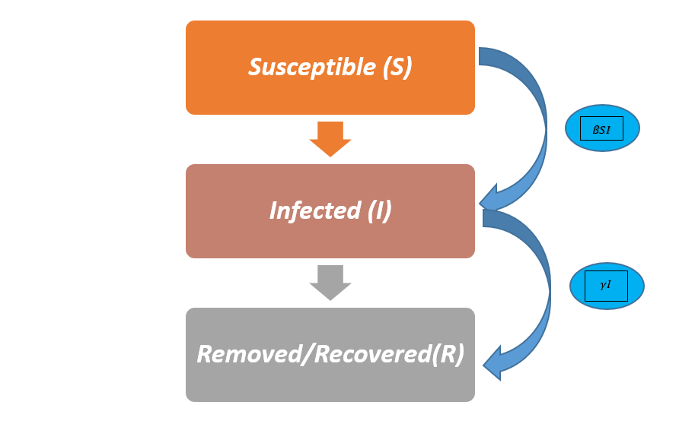
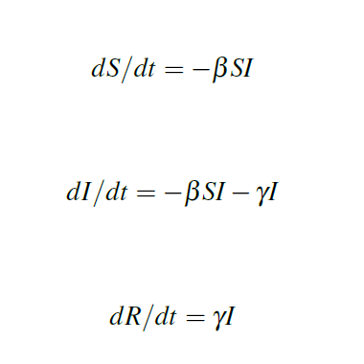
The s-i-r mODEL
It’s a compartmental model where population is divided into three compartments; S(Susceptibles), I(Infected), R(Recovered)
dS/dt represents the rate of change of Susceptible individuals over time,
dI/dt represents the rate of change of infected people over time
dR/dt represents the rate of change of recovered over time.
β is the transmission rate and is given by the average number of people one infected person
γ is the rate of recovery

Slide 9
The Reproduction Number R0 in s-i-r mODEL
Parameter for quantifying the rate of spread of virus
Not a rate and is just a ratio or a number to quantify how the virus is propagating
It is a ratio of β/γ, where the rate of transmission is given by β and rate of recovery is γ
If R0 = 1, then it means that one infected individual will infect one another susceptible individual. The number of cases in this scenario will remain constant over time
If R0 > 1, then it means that the infection is going to spread exponentially, and the number of cases will keep increasing over time
If R0 < 1, then it means that the infection will spread very slowly and die out eventually

Slide 10
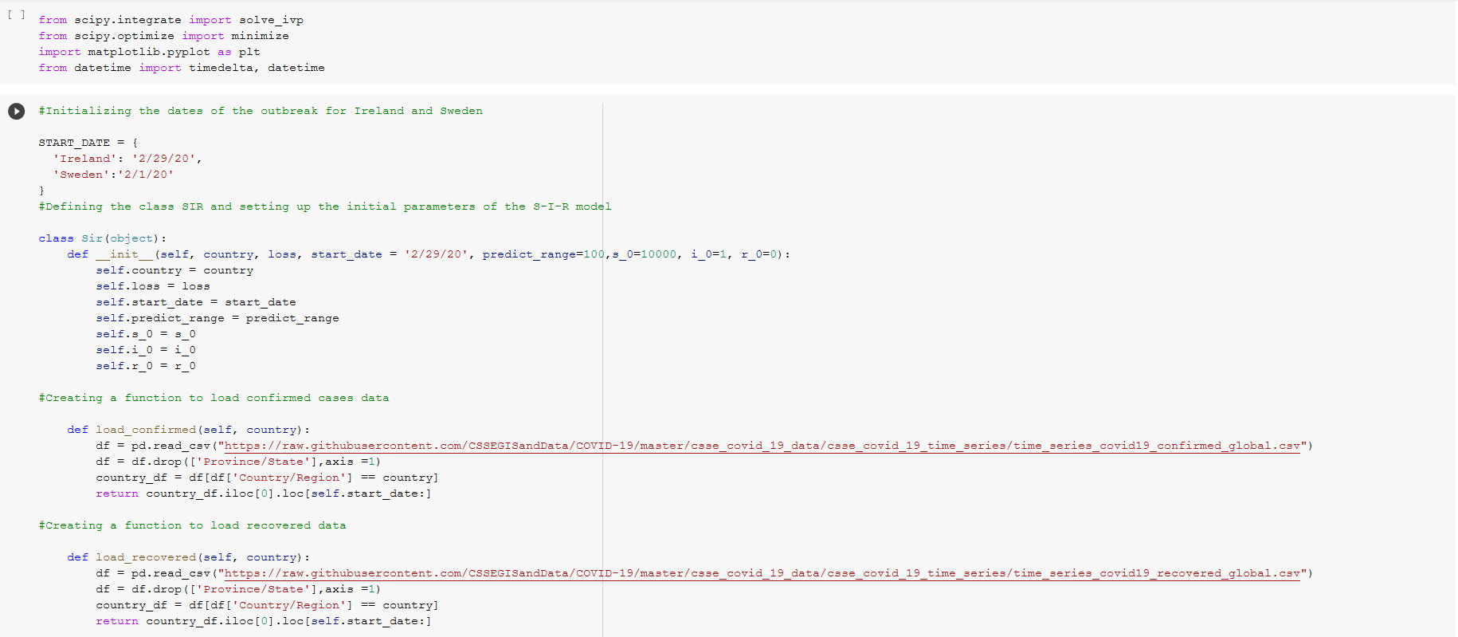
Implementation: The s-i-r mODEL
The model was defined with initial parameters in class SIR
The parameters passed were the initial infected cases(i_0), susceptible population(s_0, and recovered cases(r_0), the date of the start of the outbreak and the range for prediction(number of days) for Ireland and Sweden.
The initial population was kept at 10000 for ease of simulation
The actual infected, recovered and death data was loaded from the CSSEGIS dataset which is updated daily
Defining the s-i-r model class and loading the actual cases data

Slide 11
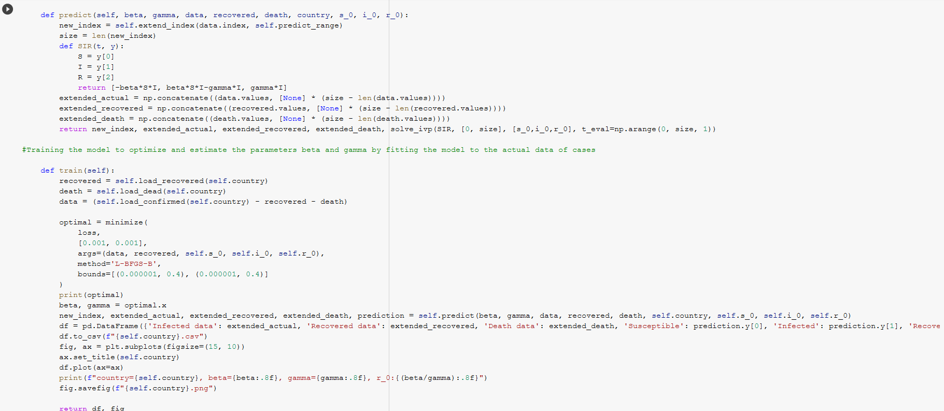
Initial Assumptions
The population is well-mixed, and every individual is equally likely to encounter other individual.
It does not consider geographical or social proximity (rate of infection is proportional to contacts)
The model does not consider birth rates and immigration of the population, and every individual of the closed population is susceptible.
The only way a susceptible individual can not be in that compartment is by being infected (constant population)
Defining the predict functions
The predict function was defined for estimating the parameters beta and gamma by fitting the model to the actual cases data
solve_ivp function in python was used to solve the ODE’s
The loss function was minimized using the root mean squared errors

Slide 12
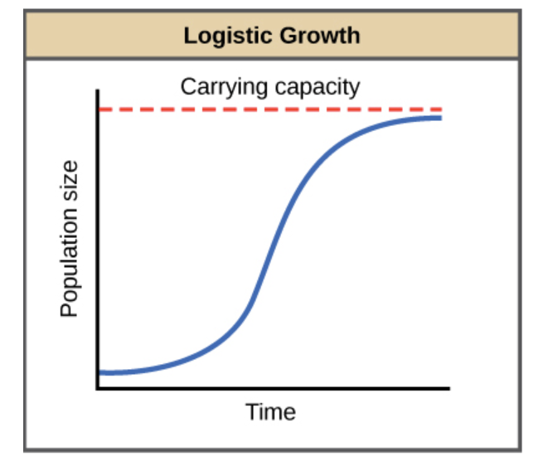
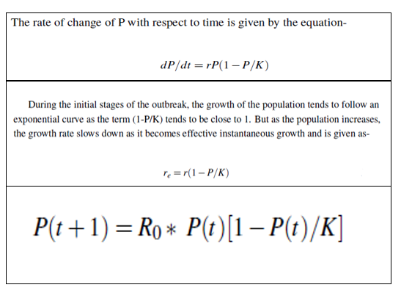
The logistic growth model
A mathematical model that describes the dynamic evolution of a population ‘P’ which is the number of infected people based on the growth rate ’r’ and the capacity of the population ’K’

Slide 13
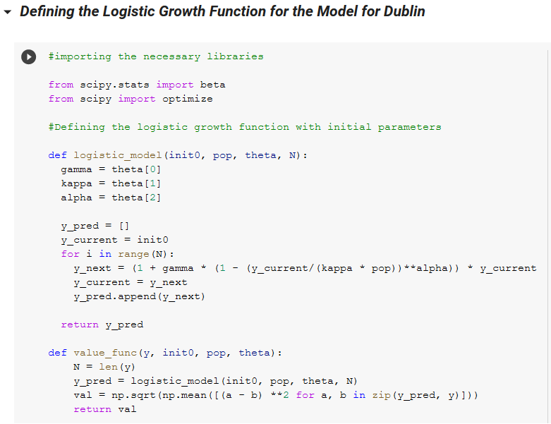
IMPLEMENTATION: Defining the model
The model was defined with initial parameters
Initial number of cases, the population and the parameters gamma, kappa and alpha were defined for the model based on the earlier logistic function equation
Here gamma is the rate of contacts with an infected person
Kappa is the probability of contacting the virus upon encounter
Alpha is the decay rate of the infection and is a tuning parameter to get better estimates
Value_func is the loss function which is minimized by reducing the mean squared errors

Slide 14
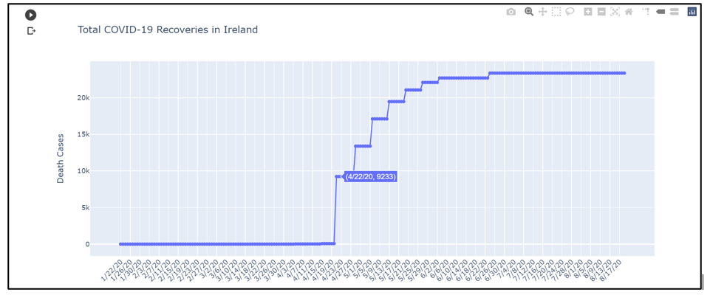
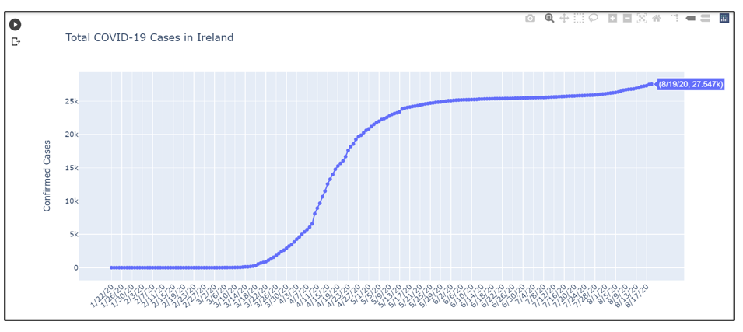
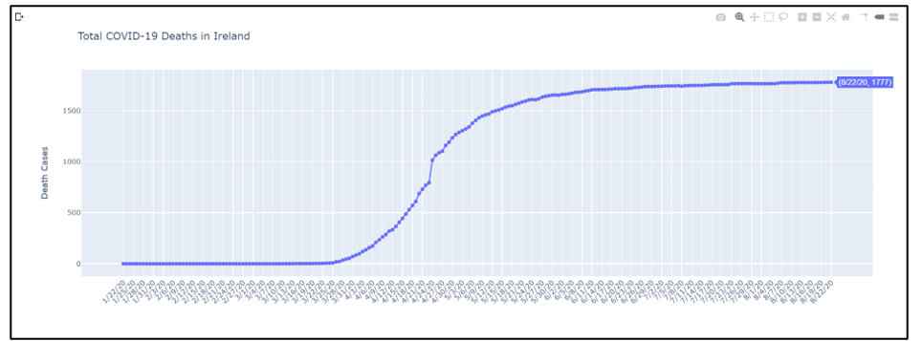
RESULTS – Exploratory Data Analysis
Aggregated cases of Ireland as of 22nd august
Total covid-19 RECOVERIES IN Ireland
Total covid-19 DEATHS IN Ireland
Total covid-19 cases in Ireland

Slide 15
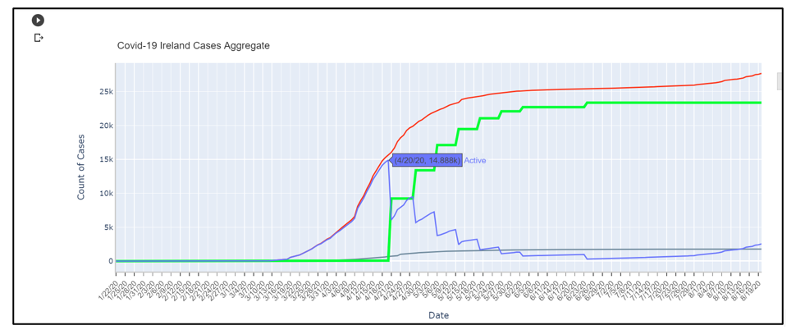
RESULTS – AGGREGATED PLOT OF OVERALL CASES IN Ireland
Total covid-19 cases in Ireland

Slide 16
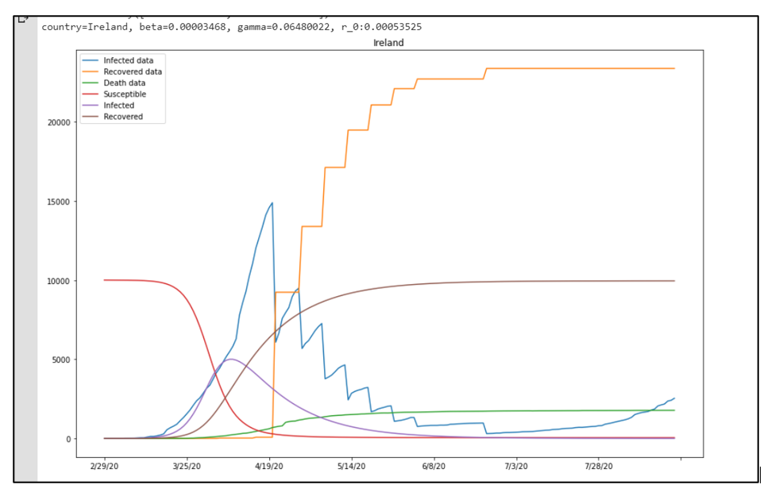
RESULTS – SIR MODEL FOR IRELAND

Slide 17
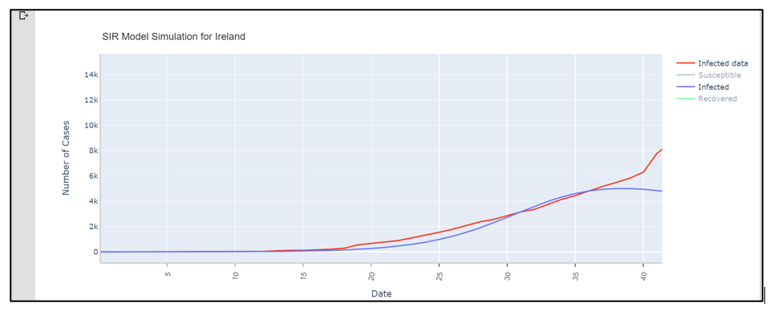
RESULTS – MODEL SIMULATION FOR FIRST 40 DAYS IN IRELAND
R2 score WAS CALCULATED AS 0.9695

Slide 18
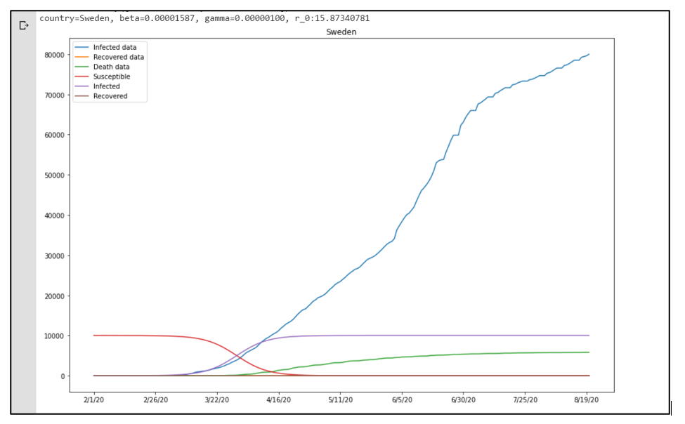
RESULTS – SIR MODEL FOR SWEDEN

Slide 19
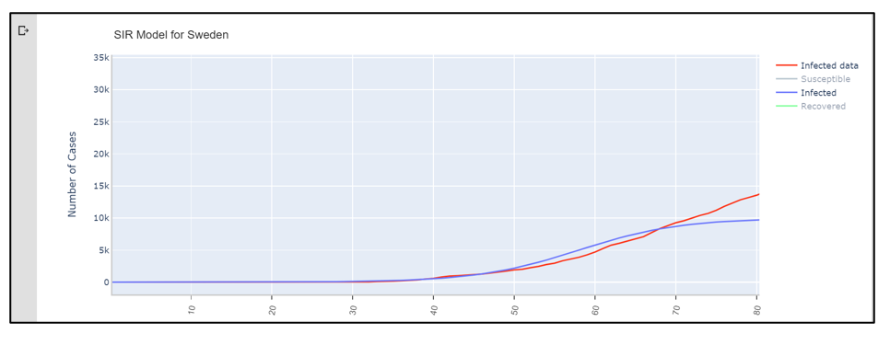
RESULTS – MODEL SIMULATION FOR FIRST 80 DAYS IN SWEDEN

Slide 20
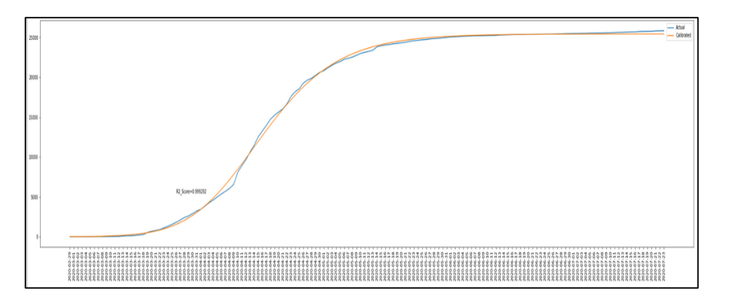
RESULTS – LOGISTIC GROWTH MODEL FOR IRELAND
R2 score = 0.9992

Slide 21
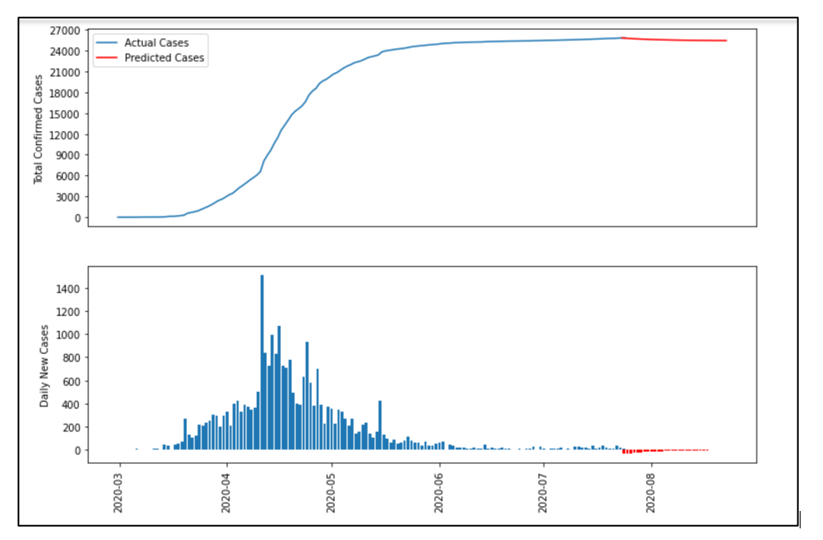
RESULTS – LOGISTIC GROWTH MODEL PREDICTIONS FOR IRELAND
Logistic model predicted an overall decrease in new cases for Ireland

Slide 22
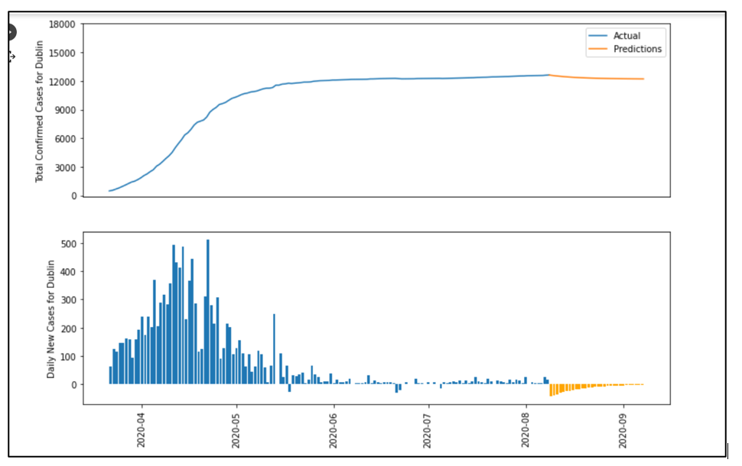
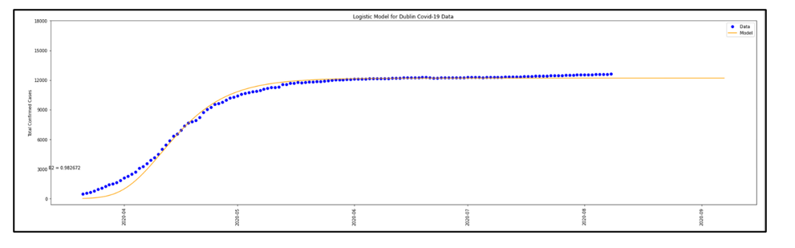
RESULTS – LOGISTIC GROWTH MODEL predictions for Dublin
Logistic model fitting for Dublin on actual data
Model predictions for Dublin in September 2020

Slide 23
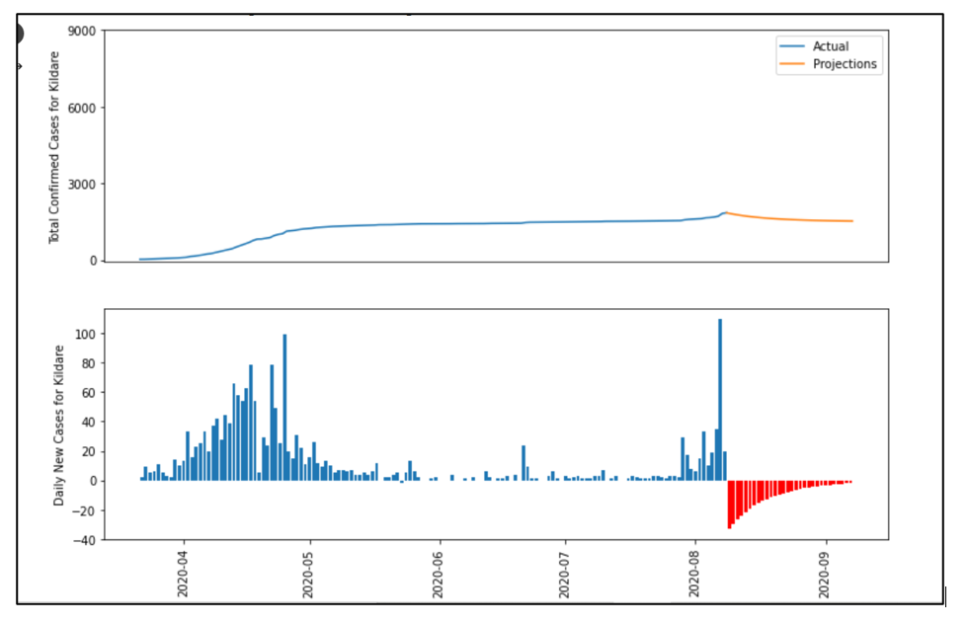
RESULTS – LOGISTIC GROWTH MODEL predictions for Kildare
Model predictions for kildare in September 2020

Slide 24
CONCLUSION
S-I-R model performed well during the initial phase of the outbreak
In later stages of the outbreak, the S-I-R model did not give satisfactory results
Logistic Growth Model, was implemented to understand the propagation of the virus during the advanced stages of the outbreak
Logistic Growth Model was more successful in fitting the model to Ireland data accurately with an R2 score of 0.992
Lockdowns and social distancing measures do play a vital role in slowing down and curbing the spread of the virus (Comparatively R0 value estimated by the S-I-R model for Sweden was greater than that of Ireland)
Logistic Growth model predicted an overall decrease in the new number of confirmed cases
The Logistic Growth model was unable to predict the re-emergence of cases and the possibility of a second wave of infections and did not account for the human factor

Slide 25
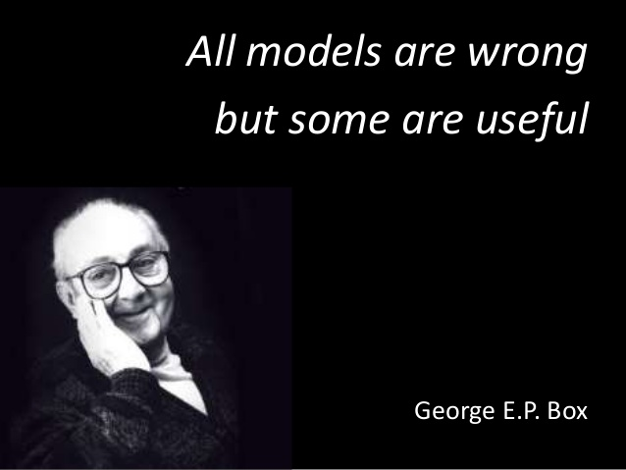
Future scope
Infection transmission rate continues to change in real world
Further road-map for this research would be to explore the non-linear dynamics of the spread of the virus and to explore the sophisticated extensions of the models.

Slide 26


THANK YOU
NEERAJ WAMAN CHAVAN
+353 0894038920
10521393@mydbs.ie

